Slide 1
The Conditional
Tutorial #7

Slide 2
OBJECTIVE

Slide 3
Objective
This tutorial will show you how to design a conditional using if and else.

Slide 4
TEXTPLANATION

Slide 5
Textplanation
Remember logic? Truth tables and logic proofs? I know. It gives you tingles of joy up and down your spine just thinking about. Well, prepare to be excited because that wonderful stuff is the foundation for conditionals. If something is true, I will do this thing. If it’s not true, I will not do this thing and I may do something else.

Slide 6
Textplanation
I'll wait while you work to contain your enthusiasm.

Slide 7
Textplanation
In order to make this whole thing work, we make comparisons and see how they stack up.
Equals (==) checks if 2 things are the same.
Greater Than (>) checks if the thing on the left is bigger than the thing on the right.
Less Than (<) checks if the thing on the left is smaller than the thing on the right.
Greater Than or Equal To (>=) checks if the thing on the left is the same as or bigger than the thing on the right.
Less Than or Equal To (<=) checks if the thing on the left is the same as or smaller than the thing on the right.

Slide 8
Textplanation
Got it?

Slide 9
Textplanation
We use these comparisons to choose paths in our code.
if (myVariable == someValue)
{
Do some cool thing.
}

Slide 10
Textplanation
Watch out for that double equals! Most programmers, experienced or not, forget to put two of them. Since the assignment operator is a single equals, if you miss that second equal sign, you’ll create a mess.

Slide 11
Textplanation
You can also set a default condition, which means you tell the computer, if my condition is true, then do x, but if my condition is not true, then do y. We use the else keyword for that.

Slide 12
Textplanation
if (myVariable == someValue)
{
Do some cool thing.
}
else
{
Do this other thing that may or may not be as cool.
}
In this case, the execution will perform either one or the other operation and then move on.

Slide 13
Textplanation
Using conditionals takes practice. There are many ways to connect them and nest them so work out your questions and your conditions before trying to code them.

Slide 14
CONSTRUCTION

Slide 15
Construction
Create a folder somewhere on your drive and label it THE NAME OF THE PAGE.
Open up notepad++.
Save the empty file to your folder and name the file “index.html”.
All first pages on a website are called index.
As you go through the images of the construction, add to your code. You will see comments with explanations of what you are doing. Those comments will change with each slide. You should not type my comments into your code.

Slide 16
Construction
Today’s construction is going to start with a little bit of review before it uses conditionals.

Slide 17
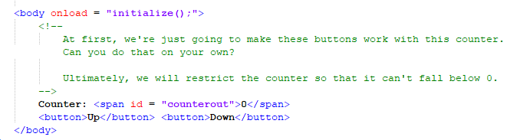
Construction

Slide 18
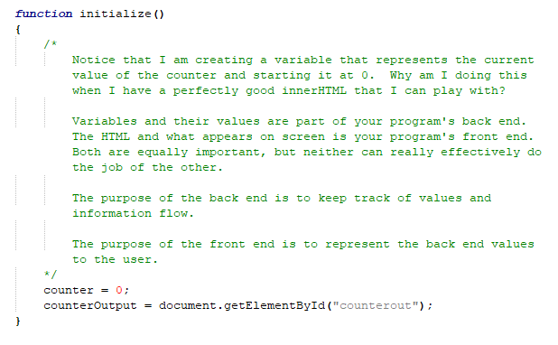
Construction

Slide 19
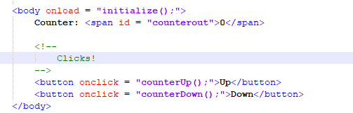
Construction

Slide 20
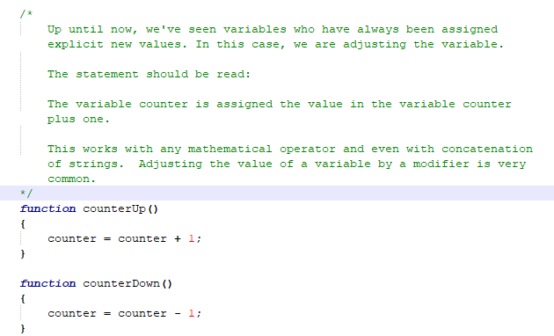
Construction

Slide 21
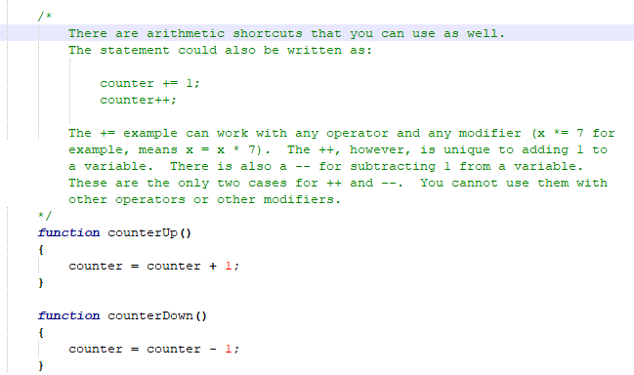
Construction

Slide 22
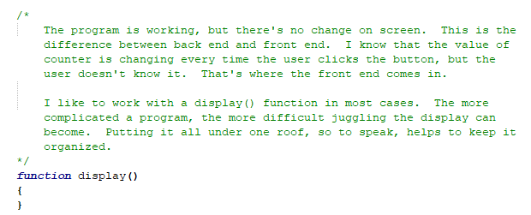
Construction

Slide 23
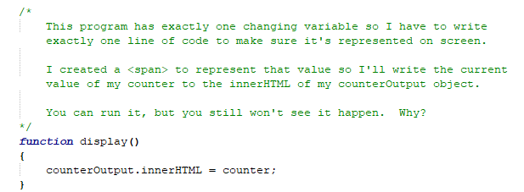
Construction

Slide 24
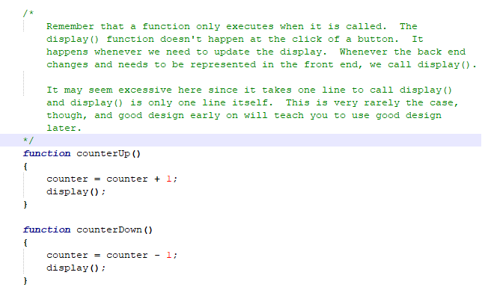
Construction

Slide 25
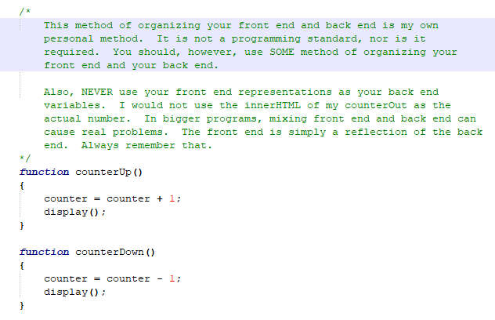
Construction

Slide 26
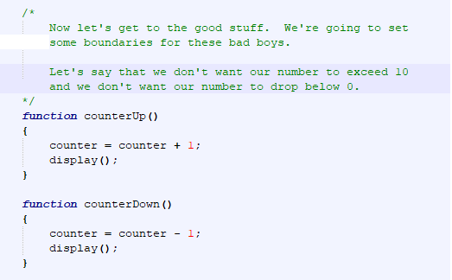
Construction

Slide 27
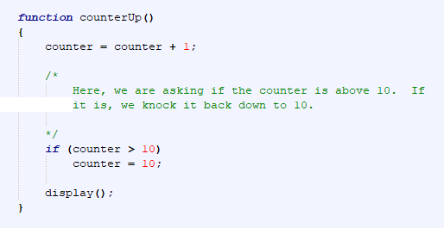
Construction

Slide 28
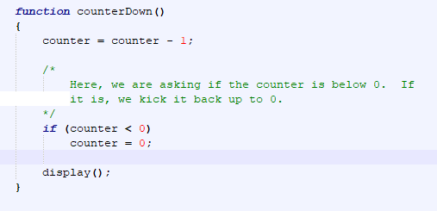
Construction

Slide 29
A DEEPER MEANING

Slide 30
A Deeper Meaning
A conditional reacts to a boolean expression. That means that whatever is in between those parentheses after your if has to evaluate to either true or false.
if (x == 3)
It either does or it doesn't, right? True or false.

Slide 31
A Deeper Meaning
How about this one?
if (myBool == true)
Same thing. The variable is either true or false. If it’s true, we have a winner. This is fine, but…

Slide 32
A Deeper Meaning
if (myBool)
What’s the difference? The variable is still either true or false. The if can still trigger off of it because it’s a boolean expression.

Slide 33
A Deeper Meaning
What if you want to test for false?
if (myBool == false)
That’s one way to do it, but…

Slide 34
A Deeper Meaning
if (!myBool)
The exclamation point (!) represents a logical not. It shows a true as a false and a false as a true.

Slide 35
A Deeper Meaning
You can also combine conditions using a logical and (&&) or a logical or (||).
if (x >= 0 && x <= 10)
This will check to see whether or not x is between 0 and 10.

Slide 36
A Deeper Meaning
if (x < 0 || x > 10)
This will check to see if x is outside the range of 0 to 10.

Slide 37
FAQ

Slide 38
FAQ
In the construction, the counter was modified and then the program asked if it had gone too far. Doesn’t it make more sense to check and see whether or not the counter will go out of range before changing it?
Sometimes (not necessarily in this case), it’s better to let the program do what it does and then clean up after its mistakes. In this case, instead of checking whether or not the counter +1 is greater than 10 or less than 0, we can check just the counter when it’s done. It doesn’t have much, if any, impact here, but when you set boundaries on a variable that can be modified in different ways, having a simple function to check if the value is legal after the fact can be much more efficient than having numerous different kinds of checks beforehand.
Remember that the user doesn’t see anything until you display it. If it works for your code, your variables can go through a multitude of improper values before reaching the correct one and your user will never know it. This is yet another good reason why it’s so important to keep your display separate from your back end.

Slide 39
ACTIVITY

Slide 40
How Low Can You Go?
Working with the counter from the Construction, create a toggle that allows or disallows negatives. If the toggle is set to disallow negatives and the number is already negative, change it to 0.

